Slide 1
General Tree

Slide 2
General Tree
A general tree (a tree) is defined to be a nonempty finite set T of elements, called nodes such that
(1) T contains a distinguished element R, called the root of T.
(2) The remaining elements of T form an ordered collection of zero or more disjoint trees T1, T2,…..Tm.
The trees T1, T2,….Tm are called subtrees of root R and the roots of T1, T2,…Tm are called successors of R.
Example:
A
B
C
D
E
F
G
H
I
J
Figure: General Tree
K
Amit Kumar Nath, Dept. of CSE, BUBT

Slide 3
Difference between General Tree and Binary Tree
A binary tree T’ is not a special case of a general tree T.
Suppose a node N has only one child. Then the child is identified as a left child or right child in binary tree T’, but no such distinction exists in a general tree T.
Example:
Tree T1
Tree T2
Amit Kumar Nath, Dept. of CSE, BUBT

Slide 4
Memory Representation of General Tree
Suppose T is a general tree. T is maintained in memory by means of a linked representation that uses following three parallel arrays:
1. INFO[K] = Information at node N
2. CHILD[K] = location of the first child of N.
3. SIBL[K] = location of next sibling of N
Here K is the location of node N of T.
Here ROOT is used as the root of T.
Example:
INFO
CHILD
SIBL
1
2
3
4
5
6
7
8
9
10
11
12
13
C
3
13
B
5
1
G
0
0
K
0
0
E
0
9
A
2
0
I
0
12
A
B
F
0
0
C
D
E
F
G
H
I
J
ROOT
6
H
4
7
J
0
0
K
D
11
0
Figure: General Tree and Its Memory Representation
Amit Kumar Nath, Dept. of CSE, BUBT

Slide 5
Correspondence between General Tree and Binary Tree
The root of T’ will be the root of T.
The left child of N’ in T’ will be the first child of node N in T and the right child of N’ in T’ will be the next sibling of N in T.
General Tree T
Binary Tree T’
A
A
B
B
C
D
E
C
E
F
G
H
I
J
F
G
D
K
H
K
I
J
Amit Kumar Nath, Dept. of CSE, BUBT

Slide 6
Binary Tree

Slide 7
Tree
A nonlinear data structure
Contain a distinguished node R, called the root of tree and a set of subtrees.
Two nodes n1 and n2 are called siblings if they have the same parent node.
Root
Subtrees
Figure: Tree
Amit Kumar Nath, Dept. of CSE, BUBT

Slide 8
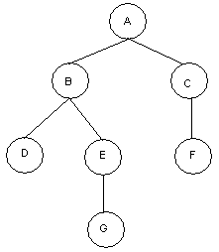
Binary Tree
A binary tree T is defined as a finite set of elements, called nodes such that:
T is empty
T contains a distinguished node R, called the root of T and the remaining nodes of T form an ordered pair of disjoint binary trees T1 and T2. T1 and T2 are called the left and right subtrees of R.
Any node N in a binary tree T has either 0, 1 or 2 successors.
Nodes with no successors are called terminal nodes or leaf nodes.
Example:
Binary Tree: T
Root: A
Nodes with 2 Successors: A, B
Nodes with 1 Successors: C, E
Terminal Nodes: D, F, G
Figure: Binary Tree T
Amit Kumar Nath, Dept. of CSE, BUBT

Slide 9


Similar Binary Trees
Two binary trees are similar if they have the same structure or same shape.
Example: T1 and T2 are similar.
T1 =
T2 =
Figure: Similar Binary Trees T1 and T2.
Copy Binary Trees
Two binary trees are copies if they are similar and they have the same contents at the corresponding nodes.
Example: T1 and T3 are copies but T1 and T2 are not copies..
T1 =
T2 =
T3 =
Figure: Binary Trees T1 and T3 are Copies.
Amit Kumar Nath, Dept. of CSE, BUBT

Slide 10
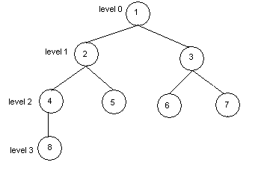
Some Basic Terms
Edge: A line from a node N of T to a successor is called is an edge.
Path: A sequence of consecutive edges is called a path.
Branch: A path from root node to a leaf node is called branch.
Level of Binary Tree: Each node in a binary tree T is assigned a level number. The root R of T has level number 0 and every other node has level number which is one more than the level number of its parent.
Depth of Binary Tree: Maximum number of nodes in a branch of T is the depth of T.
Binary Tree: T
Edge: (1, 2), (3, 6) ....
Path: (1, 2, 4), (1, 3, 6)
Branch: (1, 2, 4, 8), (1, 2, 5), (1, 3, 6), (1, 3, 7)
Depth: 4
Figure: Binary Tree T.
Amit Kumar Nath, Dept. of CSE, BUBT

Slide 11
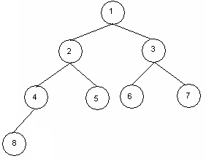
Complete Binary Trees
A binary tree T is said to be complete if all its level, except possibly the last, have the maximum number of possible nodes and if all the nodes at the last level appear as far left as possible.
The depth D_{n} of the complete binary tree with n nodes,
D_{n} =
Example:
Figure: Complete Binary Tree with Depth 4.
Amit Kumar Nath, Dept. of CSE, BUBT

Slide 12
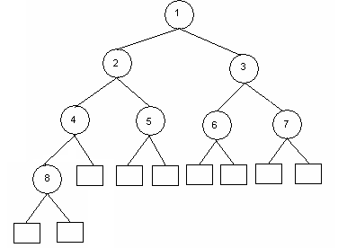
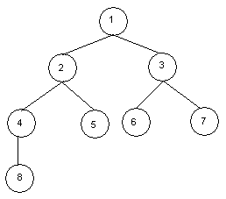
Extended Binary Tree (2-Tree)
A binary tree T is said to be an extended binary tree if each node N has either 0 or 2 children.
Nodes with 2 children are called internal nodes.
Nodes with 0 children are called external nodes.
Internal nodes are represented by circles and external nodes by squares.
Example:
Binary Tree T1
Extended Binary Tree T2
Figure: Conversion of Binary Tree into its Equivalent Extended Binary Tree
Amit Kumar Nath, Dept. of CSE, BUBT

Slide 13
Representation of Algebraic Expression Using Binary Tree
Expression E = ( ( a + b ) * r + w / t ) * x
*
+
x
*
/
+
r
w
t
a
b
Figure: Binary Tree T Expressing the Algebraic Expression E.
Amit Kumar Nath, Dept. of CSE, BUBT

Slide 14
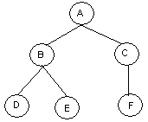
Representing Binary Tree in Memory
Let T be a binary tree. T can be represented in memory using two ways.
1. Linked Representation 2. Sequential Memory Representation
Linked Representation of Binary Tree
Use Three parallel arrays Info, Left and Right and a pointer variable Root.
Info[K]: Contains data at node N.
Left[K]: Contains location of left child of N
Right[K]: Contains location of right child of N
Root: Contains location of Root
Example:
Info
Left
Right
1
C
0
10
2
D
0
0
3
4
E
0
0
5
A
7
1
6
Root
7
B
2
4
8
9
10
F
0
0
Figure: Binary Tree T and its linked representation.
Amit Kumar Nath, Dept. of CSE, BUBT

Slide 15
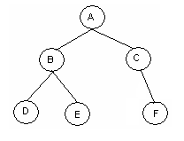
Sequential Representation of Binary Tree
Use only a single liner array Tree.
Tree[1] represents the Root of T.
If node N is in Tree[K], then its left child is in Tree[2K] and right child is in Tree[2K+1].
Tree[1] = NULL indicates T is empty.
Example:
1
2
3
4
5
6
7
8
9
10
Tree =
A
B
C
D
E
F
Figure: Binary Tree T and its sequential representation.
Amit Kumar Nath, Dept. of CSE, BUBT

Slide 16
Traversing a Binary Tree

Slide 17
Traversing Binary Tree
There are 3 ways of traversing a binary tree T having root R.
1. Preorder Traversing
Steps:
(a) Process the root R
(b) Traverse the left subtree of R in preorder.
(c) Traverse the right subtree of R in preorder.
Example:
A
B
C
Preorder Traversal of T
A, B, D, H, E, C, F, I, J, G
D
E
F
G
H
I
J
Figure: Binary Tree T
Amit Kumar Nath, Dept. of CSE, BUBT

Slide 18
2. Inorder Traversing
Steps:
(a) Traverse the left subtree of R in inorder.
(b) Traverse the root R.
(c) Traverse the right subtree of R in inorder.
Example:
A
B
C
Inorder Traversal of T
D, H, B, E, A, I, F, J, C, G
D
E
F
G
H
I
J
Figure: Binary Tree T
Amit Kumar Nath Dept. of CSE, BUBT

Slide 19
3. Postorder Traversing
Steps:
(a) Traverse the left subtree of R in postorder.
(b) Traverse the right subtree of R in postorder.
(c) Traverse the root R.
Example:
A
B
C
Postorder Traversal of T
H, D, E, B, I, J, F, G, C, A
D
E
F
G
H
I
J
Figure: Binary Tree T
Amit Kumar Nath, Dept. of CSE, BUBT

Slide 20
END!!!

